Slide 1
Proposal Defense
Ingestion of Common Microplastics by Hemigrapsus oregonensis in a Combined Diet versus Isolated Particles

Slide 2
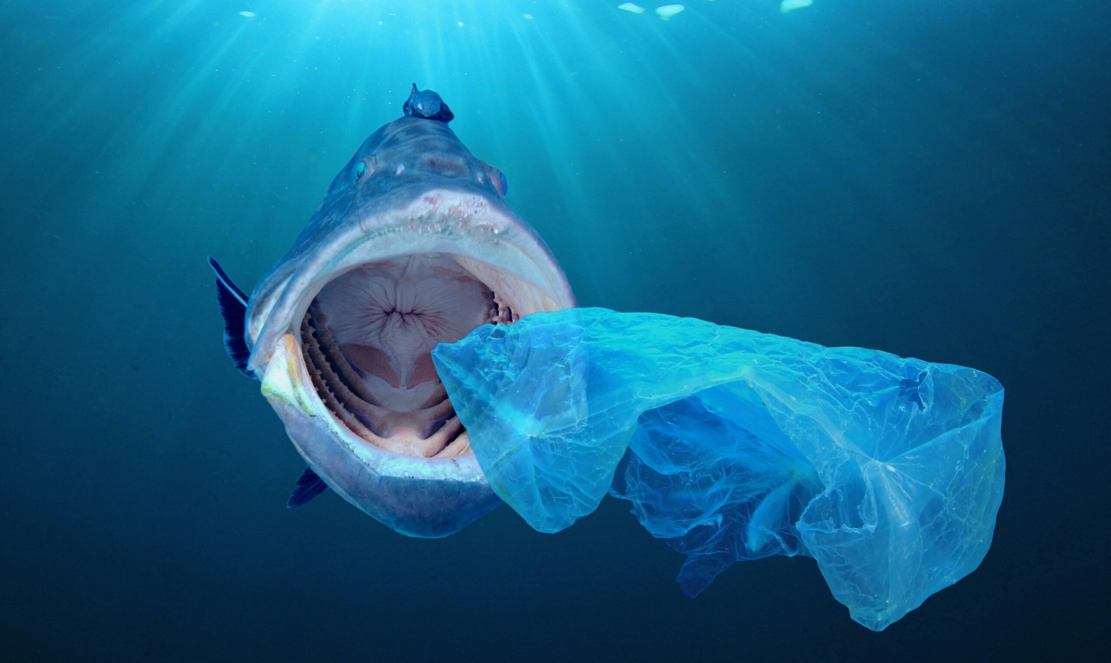
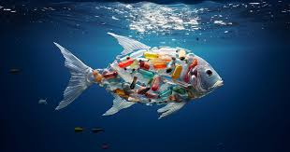
Background - MPs
Microplastics (MPs) are small plastics (<5mm)
UV, wave action, and wind fragment particles
Large presence in marine environment
Small debris enter through oral or respiratory cavities
Induce alterations in physiology and biochemistry

Slide 3
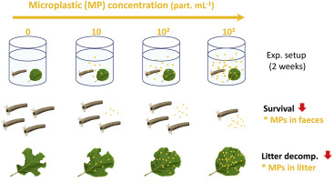
Background - Physiological harm
Metabolic rate: Temperature stress additive with plastic stress in amphipods
Feeding: Blockages in invertebrate intestines
Growth rate: Reduced growth rate in amphipods
Behavior: Swimming behavior in copepods and fish social behavior after accumulation in brain
Key ecological interactions are at risk for those affected:
Leaf litter decomposition by key invertebrates was reduced in a freshwater system, altering ecosystem functions.

Slide 4
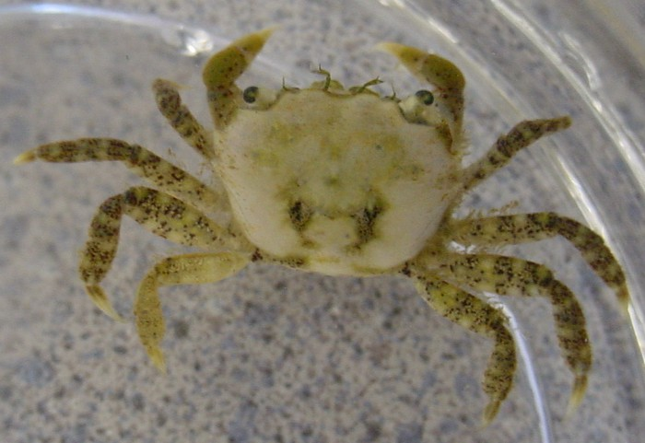
Background - Hemigrapsus Oregonensis
Small (35mm x 28mm)
Sexual dimorphism
Interact with isopods, algae, pickleweed, host many parasites
late-winter/early-spring reproduction
Nutrient cycling
Natural predators: Shore Birds
Unnatural predators: European green crab

Slide 5
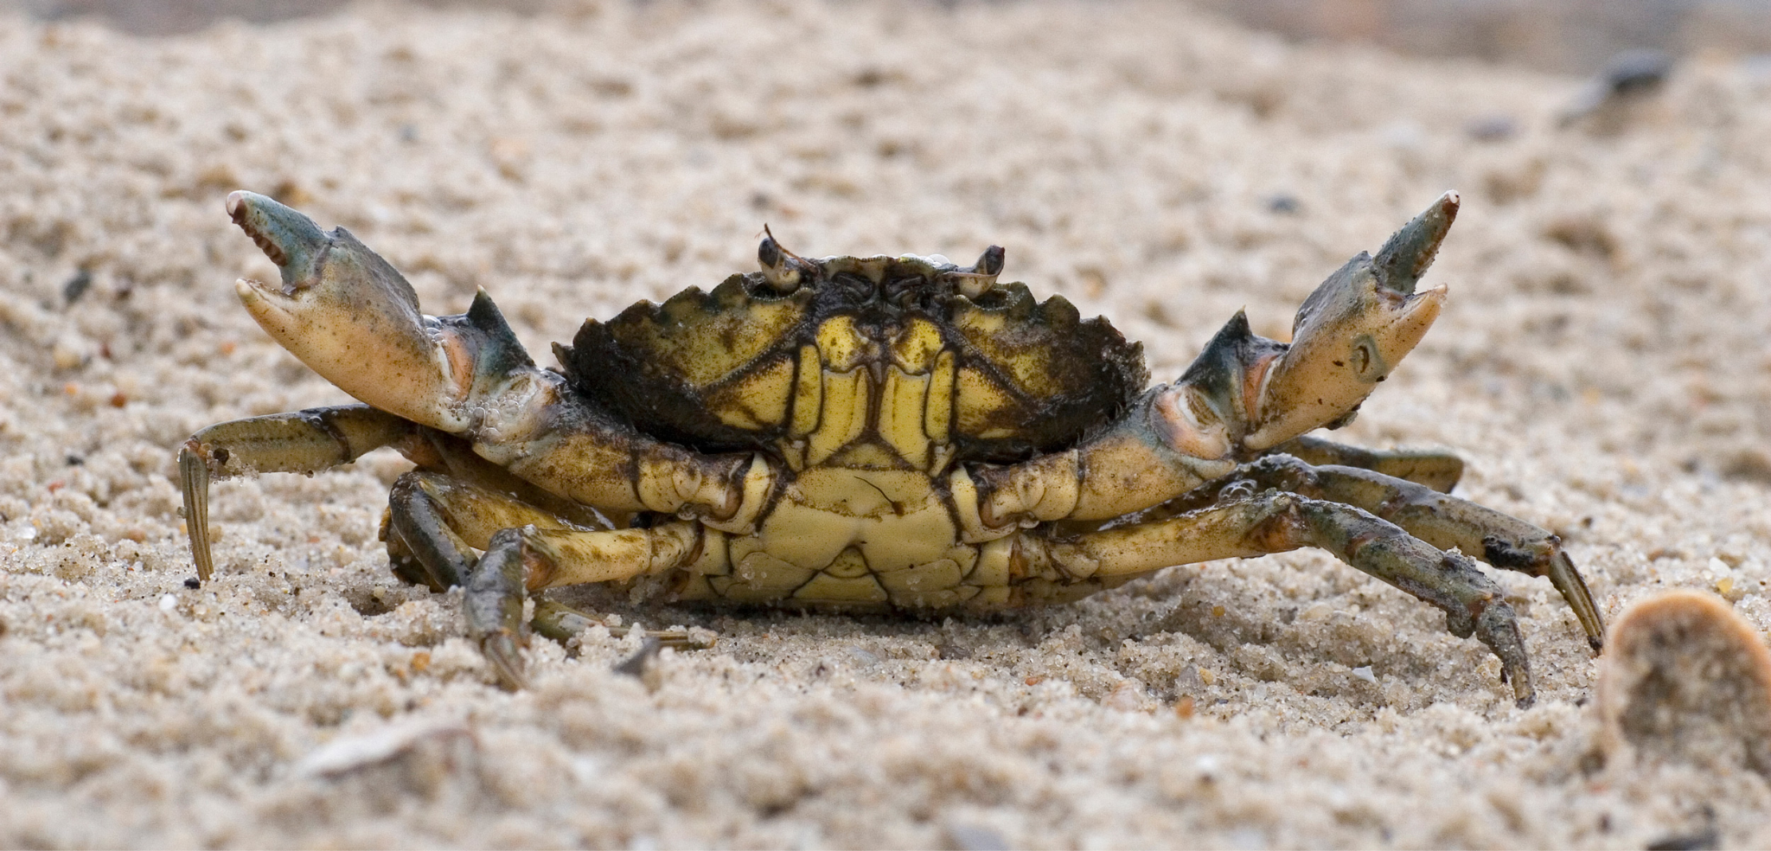
Background - European green crabs
Competing invasive species such as European green crab (Carcinus maenas) outcompete native species
Comparative responses to microplastic accumulation is not well understood
Diet of H. Oregonensis
Could infer green crab plastic accumulation.

Slide 6
Research Question
Do microplastics impact oxygen uptake in hairy shore crabs and/or accumulate in their gills and tissues?
H (0): No impact of oxygen uptake and microplastics will not accumulate
H (a): Decreased oxygen uptake and microplastic accumulation in gut and gills
Notes:
Added this slide on Zach’s recommendation!

Slide 7
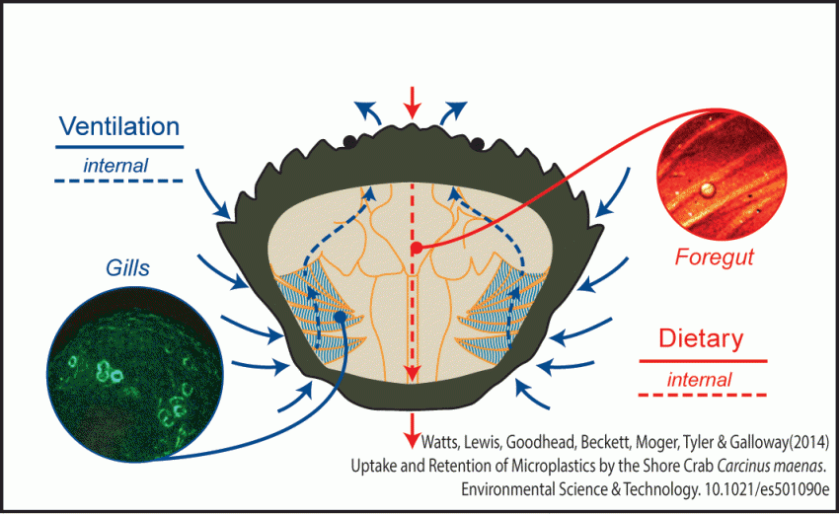
Research Question & Hypotheses
Microplastics will affect the rates of CO2 production in yellow shore crab species
Microplastics impact the rate of digestions, causing intestinal damage
Polypropylene plastic caps impact the metabolic pathways of yellow shore crab species due to intestinal damage and reduced oxygen intake, resulting in a decrease in CO2 production and lowered mobility and activity rates.
Null Hypothesis: Microplastics feature no effect on the metabolic rate of crabs

Slide 8
Research Question & Hypothesis
How do microplastics affect shore crabs & crab species in general in accordance with the production of CO2?
Intestinal blockage: Debris accumulation within the digestive tract of crustaceans decrease the available surface area for nutrients absorption
Clearance rates of MP from chronic exposure exacerbates nutrient malabsorption
Chemical compounds can disrupt and impede metabolic functions on a cellular level

Slide 9
Research Question & Hypothesis
What outcomes do we expect if the Hypothesis is true?
Primarily we should note a decrease in the overall uptake of O2 and a downstream effect of lowered CO2 production
Decreased metabolic activities result in less energy available; this will cause an overall decrease in physiological processes
A decrease in the available food supply, since more nutrients are needed to sustain metabolic function

Slide 10

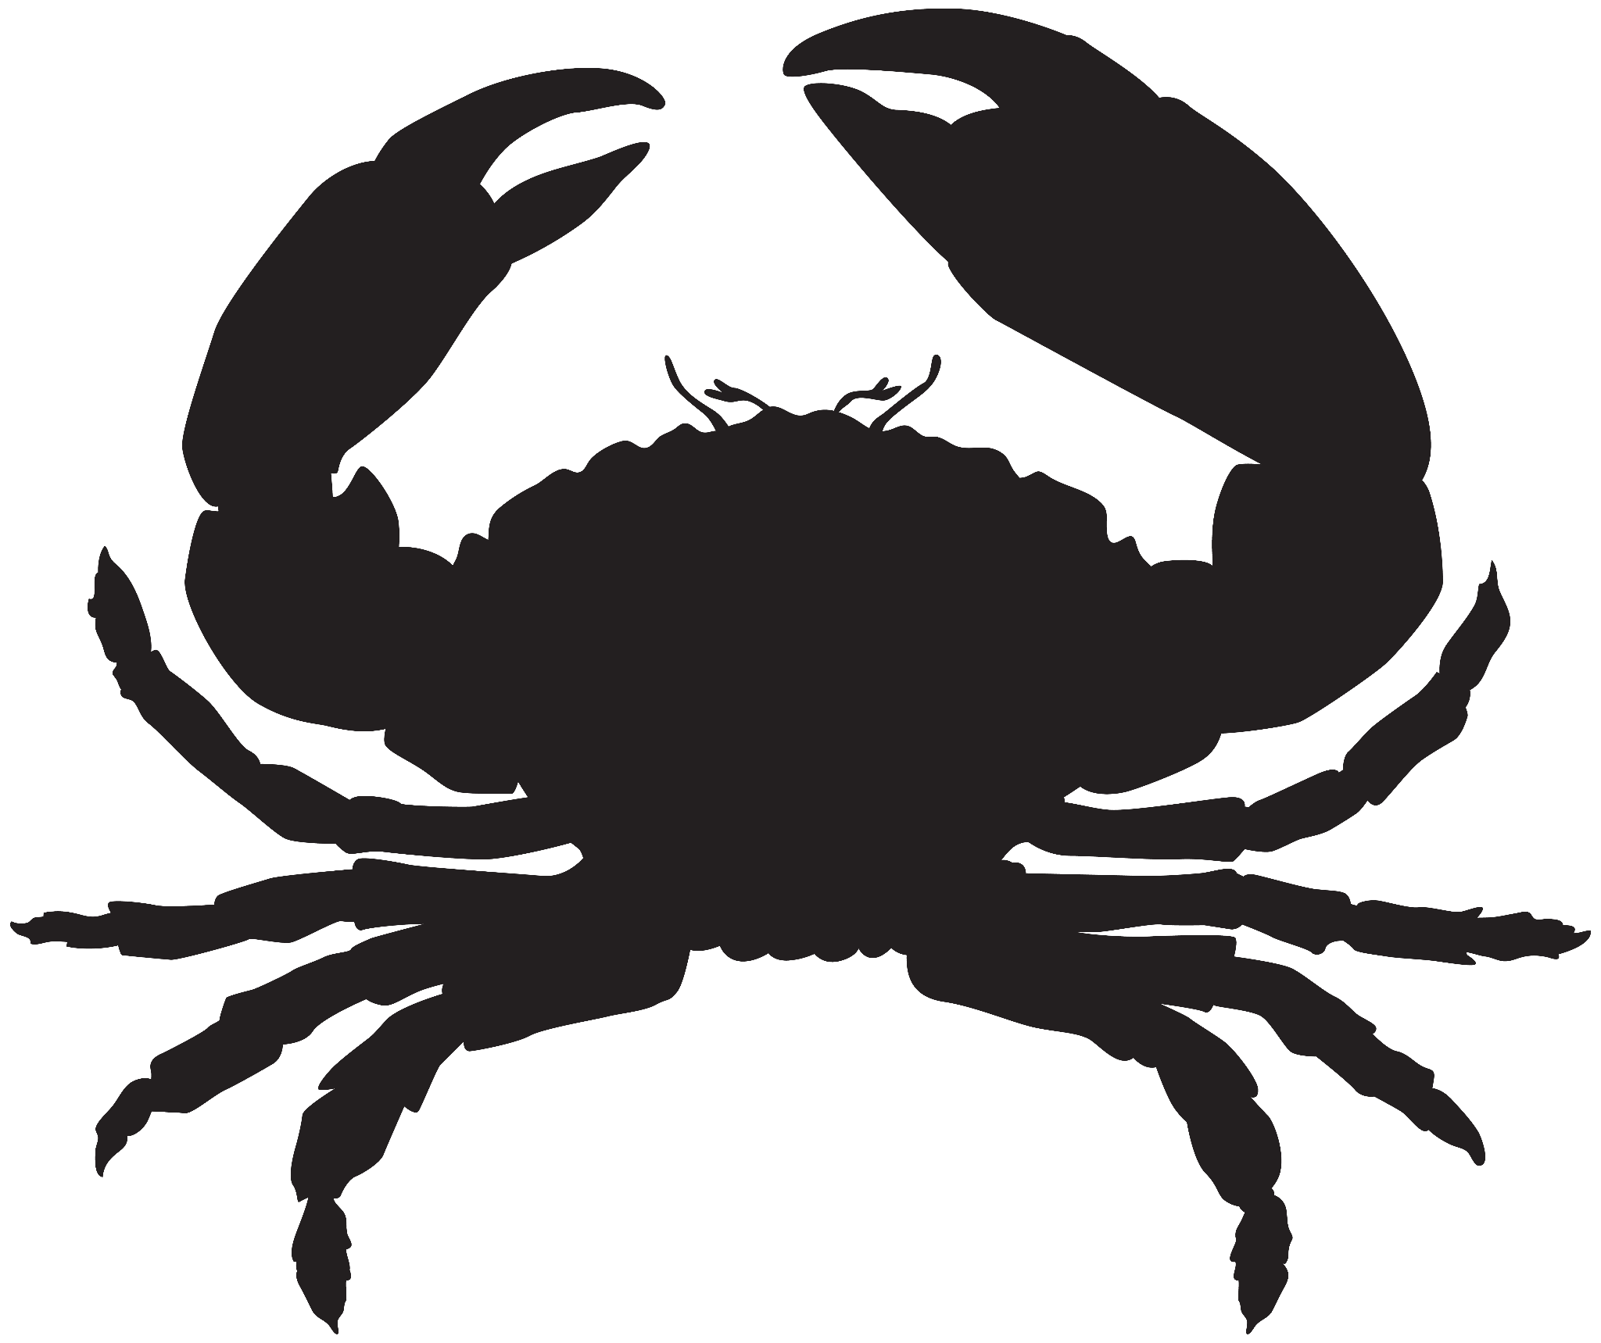
Experimental Design
Parameters measured:
Respirometry with Resazurin
Microplastic particles counted
Glucose (TBD)
BCA protein (TBD)
Jarred crabs in two groups, maintained in identical conditions
MPs in alone group “scented” with fish material before feeding
n = 10
n = 10
Group #1 - MPs & food
Group #2 - MPs alone

Slide 11
Setup
The crabs will be held at approx. 13°C in individual jars within a larger tank (10-15 gal).
The water will be kept at a salinity of 30 ppt
Microplastic preparation
Obtain blue bottle caps (mixed plastic, color: blue)
Shave plastic to MP with file
Marinate MP in mackerel juice (2hr)
Prepare feeding samples for MP group and MP + food group
Group #1: 2.5g MPs + food mixture (1% plastic, 25mg)
Group #2: 25mg MPs (marinated plastic pieces)

Slide 12
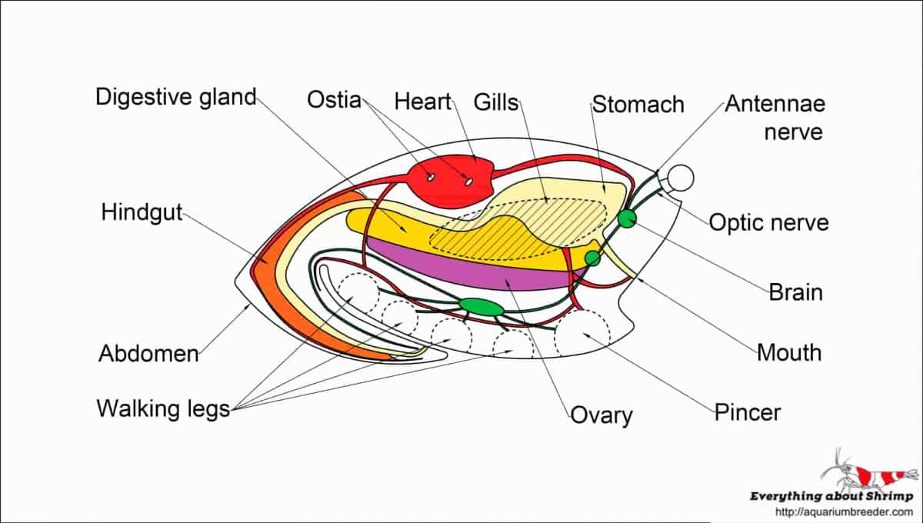
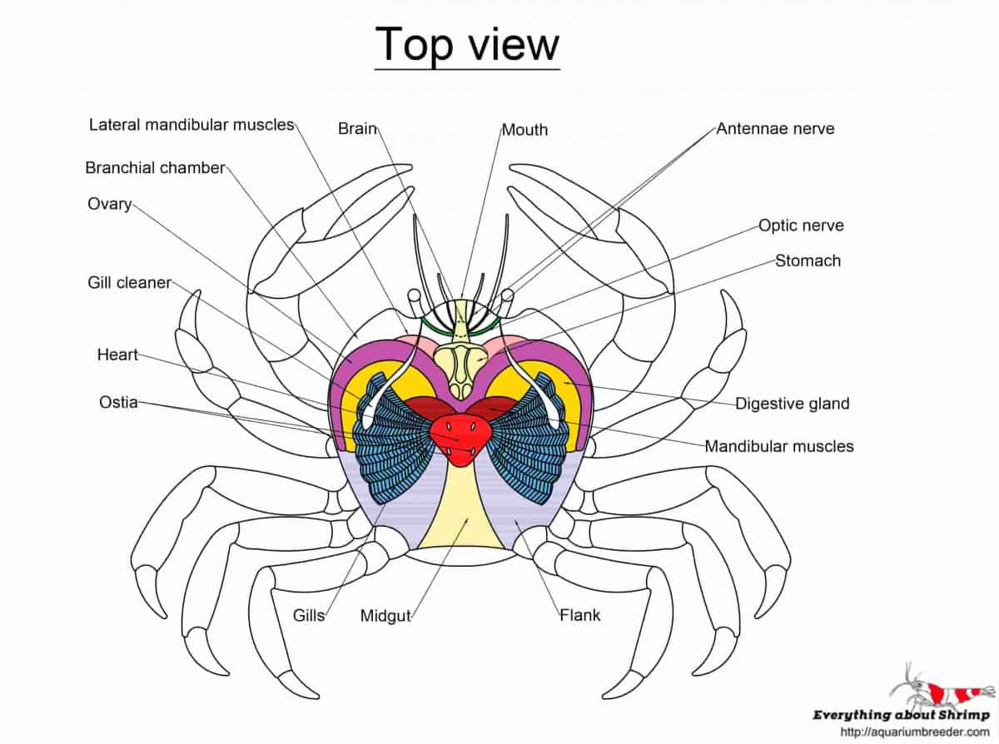
Dissection Process
At end of experiment, all crabs weighed then dissected
Examining digestive tract, claw muscle, and gills for particles
Use ImageJ to count plastic particles for each area examined
Notes:
ImageJ # and area of plastic particles -> assume spherical particles, calculate volume -> use known density to calculate mass of plastic in each crab -> divide by total mass of crab to get standardized values for plastic retention
https://aquariumbreeder.com/crab-internal-anatomy/

Slide 13
Questions?

